Slide 1

yarnnn
Autonomous agents that know your work.
They connect to your platforms. They accumulate knowledge. They work while you don't.
(Pre) Seed Round 2026
Kevin Kim · kvkthecreator@gmail.com

Slide 2
It looks like the big players will own everything.
Claude has coding agents, desktop, cowork.
ChatGPT has memory, Codex, Sora.
The market assumes they’ll consume every layer.
But every platform cycle looks that way — until it doesn’t.
Google didn’t become Salesforce.
Facebook didn’t become Shopify.
AWS didn’t become Datadog.

Slide 3
The Honest Bet
History never repeats, but it does rhyme.
Our thesis is that even with the AI tech revolution, the application layer is yet to come.
2008: Google
→ Looked like it would own everything on the web. It didn’t become Salesforce.
2012: Facebook
→ Looked like it would own all of social commerce. It didn’t become Shopify.
2015: AWS
→ Looked like it would own every cloud application. It didn’t become Datadog.
2026: LLMs
→ Look like they’ll own every layer. But code was the easy case. Work context is the hard one.
The application layer of the AI platform shift is yet to come, and we’re taking the bold bet that it will be Agent-native, and the work economy will shift from human -> agents

Slide 4
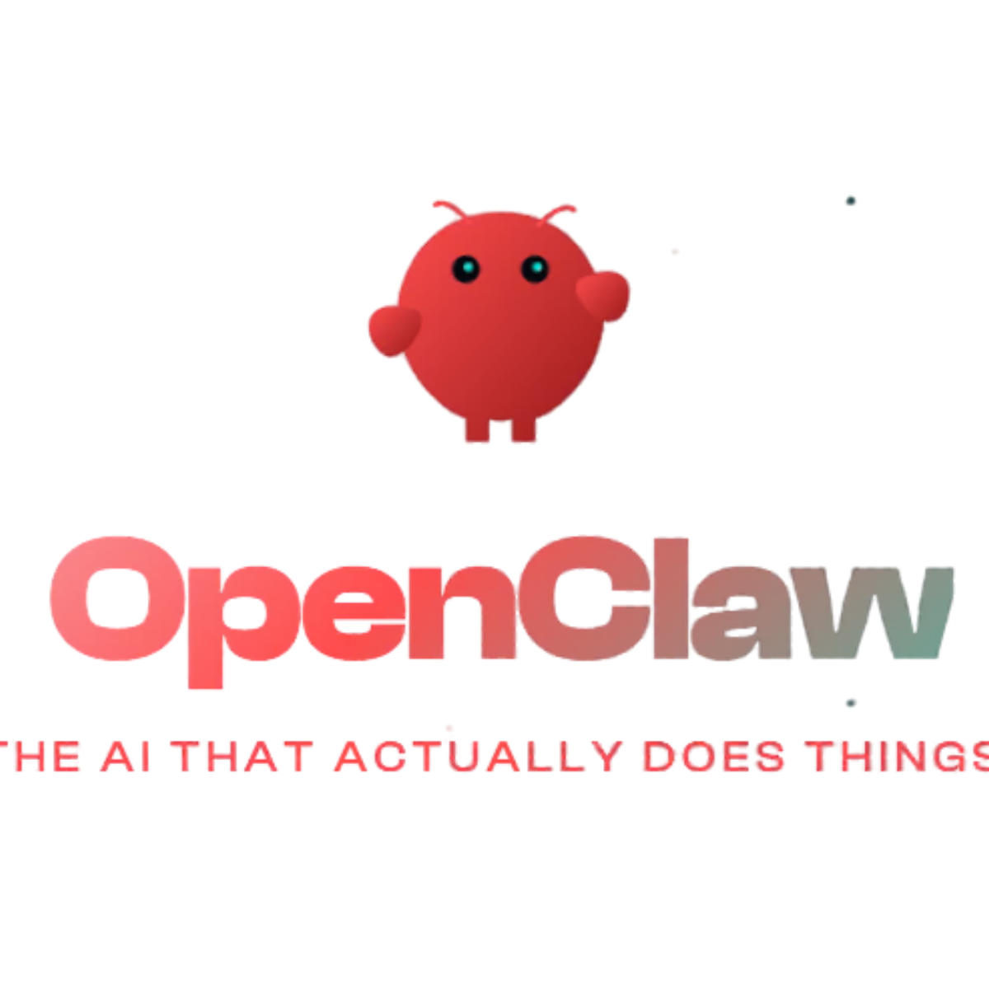
Proof of Demand
ClawdBot proved the appetite is real.
17,830
But 95% of people can't use it.
GitHub stars in 24 hours
High technical barrier, privacy, hardware setup
Fastest single-day growth in GitHub history.
"The first time I've felt like I'm living in the future since ChatGPT launched."
✘ Requires VPS provisioning (only 5% can do this)
✘ 200+ security leaks detected (GitGuardian)
— ClawdBot user
✘ No project isolation or recurring workflows

Slide 5
Product
Architecture
Solution / Moat

Slide 6
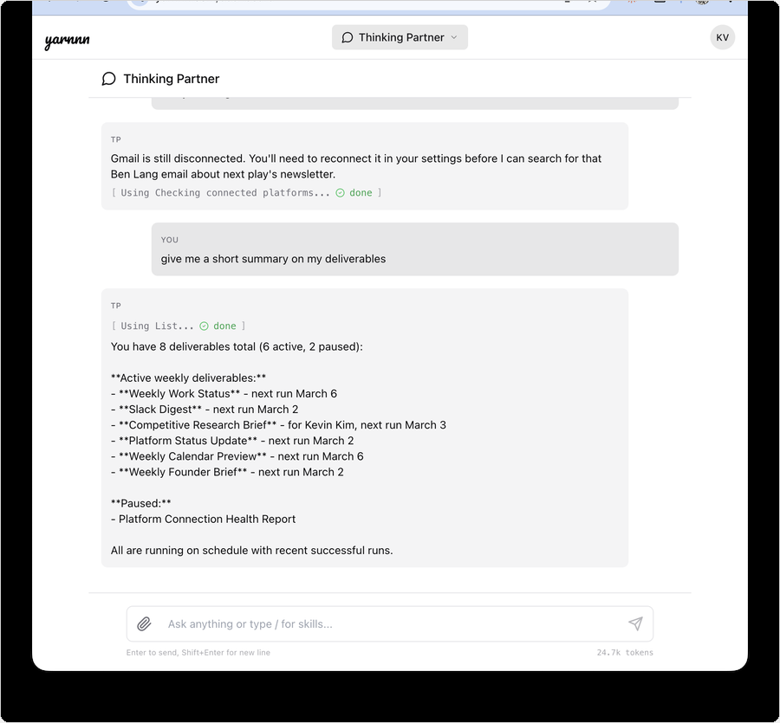
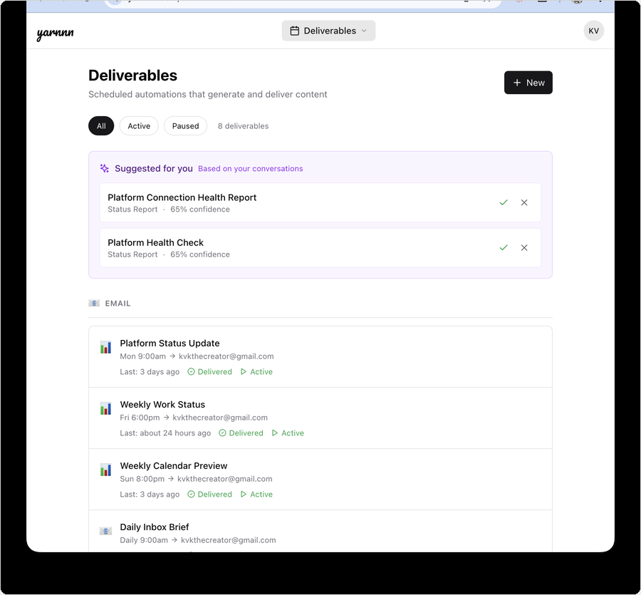
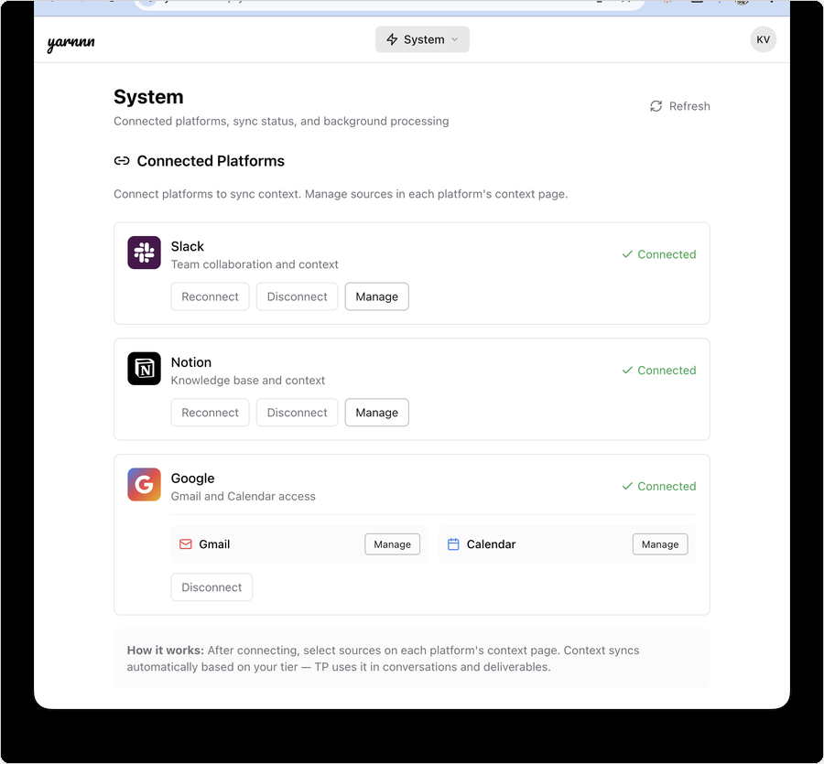
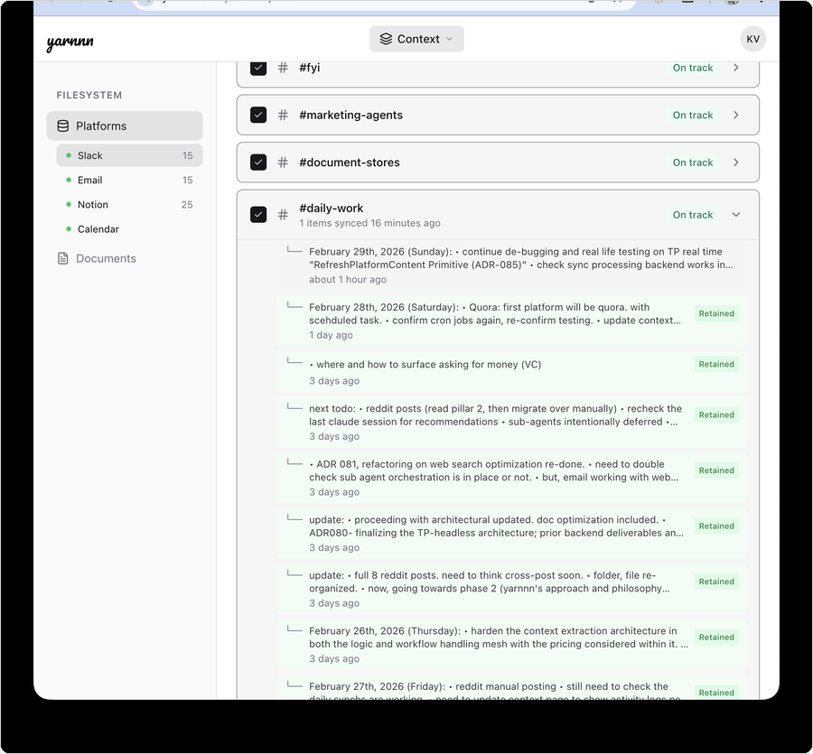
Product: Meet yarnnn's Orchestrator
Your autonomous agent network. Live at yarnnn.com.
01
Chat Mode
02
Headless Mode
03
4 Integrations
04
Context Engine
Ask anything. It already knows your work. Built like Claude Code with capabilities and webSearch
Autonomous agents on schedule. Persistent agents with inspectable workspaces
Slack, Gmail, Notion, Calendar.
With more in product roadmap
Gets smarter every sync cycle.
Knowledge accumulation, workspace memory

Slide 7
Agent Architecture and Orchestration
Built for Agent-native, autonomous workflows
Every layer purpose-built so knowledge compounds — creating recursive feedback between agent output and accumulated intelligence
Perception Pipeline
Slack • Gmail Notion • Calendar
Knowledge Base
Unified content Retention + provenance
Memory
Working + user memory Implicit extraction
Agent Engine
5 execution modes Chat + headless
Agents
Persistent autonomous output
→
→
→
→
Why this can’t be bolted on:
Big Players, LLM Providers
Agent Startups
Workspace AI
No persistent cross-platform knowledge.
Optimized for breadth, not individual depth.
Architectural gap.
Task execution focused.
No accumulated knowledge layer with feedback loop
Single-platform. Can’t synthesize across tools.
No persistent agents.
Every layer purpose-built for knowledge accumulation, true autonomy + intelligence

Slide 8
Product
Your Agent Network
Platform specialists accumulate knowledge. Synthesis agents produce work you’d never get from a single tool.
RECAP AGENT
MEETING PREP AGENT
STATUS + WATCH AGENTS
Platform Digest
Calendar-Driven Briefs
Synthesis + Proactive Intel
What happened while you weren’t looking. All platforms synthesized into one brief.
Full attendee context from Slack + Gmail + Notion. Delivered before every meeting.
Cross-platform status updates for any audience. Proactive alerts when pricing or competitors surface across channels.
EXAMPLE:
EXAMPLE:
EXAMPLES:
Monday morning: here’s everything from #engineering, your inbox, and 3 Notion updates. Gets better every week.
You meet Sarah at 2pm. Here’s her last 5 Slack threads, 2 emails, and the Notion doc she edited yesterday.
Weekly client update from Slack + Gmail + Notion. No copy-paste. Competitor mention detected across 3 channels. Brief generated.

Slide 9
Solution: Moat
Knowledge Compounds. Switching Costs Follow.
Every agent run makes the next one better. Every edit teaches the system. Every sync deepens the knowledge base.
Platforms (Slack, Gmail, Notion, Cal)
Connect
Accumulate
Automate
Supervise
Three moat mechanics:
1
Accumulation: Every sync cycle deepens cross-platform understanding. Agents don’t start from zero.
2
Recursion: Your edits and feedback train agent output quality. The 5th run needs fewer corrections than the 1st.
Compounding Work Intelligence
3
Irreversibility: 90 days of accumulated knowledge can’t be exported or replicated. Switching means starting over.
Edits, refine
memory
Knowledge syncs
Autonomous Agent System

Slide 10
Product
What YARNNN Replaces
Three real workflows. Before: manual, fragmented, time-consuming. After: autonomous, cross-platform, improving.
BEFORE: Monday Catchup
Open Slack. Scroll 14 channels. Open Gmail. Scan 40 emails. 45 minutes gone.
AFTER: Recap Agent
One brief. All platforms. Waiting at 8am. 0 minutes of your time.
BEFORE: Client Status Update
Copy from Slack. Paste into doc. Check Gmail. Rewrite for client tone. 2 hours, every week.
AFTER: Status Agent
Pulls from all platforms. 12 weeks of accumulated context. Draft arrives Friday 5pm.
BEFORE: Meeting Prep
Search Slack. Search Gmail. Check LinkedIn. Skim Notion. Scramble 10 minutes before the call.
AFTER: Meeting Prep Agent
Brief auto-generated from calendar. Full context. Delivered 30 min before. Every time.
Every agent gets better with tenure. The 12th weekly update needs zero corrections.

Slide 11
Positioning • Market •
Competitive Landscape

Slide 12
Positioning
Not another chatbot. Not another agent framework.
The only platform where persistent agents accumulate cross-platform work knowledge for autonomous output.
Autonomy
yarnnn
Big-Players
ChatGPT/Claude
Agent Startups
Mem.ai, Genspark
Workspaces Notion, Slack
Cross-platform knowledge accumulation
✓ Evolving
✘
✘
Single
ChatGPT
yarnnn
Claude Cowork / Genspark
Cross-platform sync
✓
✘
✘
✘
Knowledge
Accumulation
Autonomous output
✓ Scheduled
✘
✓
✘
Improves with tenure
✓ Accumulation
Evolving
✘
✘
Existing
Workspaces
Agent-based
Startups
Context-aware agent
✓
Evolving
✘
Basic

Slide 13
Market
Starting with solo consultants. Expanding from there.
Entry wedge: Solo consultants with recurring client obligations
TAM
SAM
Entry SOM
$4.35B
$1.14B
$4.6M
AI productivity tools market (31% CAGR)
~5M solo consultants globally × $228/yr (Pro annual)
20K consultants in first 3 years
Expansion path:
Now
Solo consultants
Recurring reports, clear pain, willing to pay
Next
Founders & executives
Investor updates, board prep, strategic briefs
Then
Teams & ops leads
Standups, project reports, cross-team synthesis
Scale
All knowledge workers
Any professional with recurring work obligations

Slide 14
Pricing Model
Two tiers. Knowledge depth is the lever.
Free
Pro
Enterprise
$0
/mo
$19
/mo
TBD
/mo
• 2 platforms connected
• 4 platforms connected
• Everything in Pro
• 5 sources per platform
• Unlimited sources
• Team workspaces
• Sync 2x/day
• Hourly sync
• Priority support
• 50 orchestrator messages/mo
• Unlimited orchestrator messages
• Custom integrations
• 2 active agents
• Unlimited agents
• Agent-to-agent protocol
Unit economics: Target 70%+ gross margin at scale. Batched sync and cached knowledge reduce per-user API cost as context accumulates.
Yearly plan: 2 months free (17% off). Pro $190/yr.

Slide 15
Product Roadmap
Context layer first. Autonomy second. Protocol third.
Each phase expands the moat. More context surfaces unlock deeper autonomy and broader interoperability.
NEAR-TERM <6mo.
MEDIUM-TERM 12-18mo.
LONG-TERM +12mo.
Expand the Context Surface
Long-term Autonomy Agent
Agent-to-Agent Protocol
Linear, GitHub, MS Office, Google Drive
Every new integration deepens the accumulation moat
Cross-platform knowledge is what makes agents intelligent
Move from proactive review to full autonomous execution
Agent drafts, schedules, and acts on your behalf with accumulated context
Trust earned over time: the more it knows you, the more you delegate
YARNNN becomes the context layer other agents talk to
Interop with external AI agents via standardized protocol
Platform play: own the work context graph, not just one agent

Slide 16
(Pre) Seed - The Ask
$500K at $5M post-money valuation.
Use of funds:
Why now:
Positioning:
→ Tech Lead (memory/ML)
→ ClawdBot: 17,830 stars / 24hrs
→ Application layer sill pre-mature
→ GTM Lead (creator community)
→ No one owns the context layer
→ True Agent-native architecture
→ 12 months runway
→ Architecture built, need team
Priority 0: Team-Building
Betting on an agent-first future:
Differentiation:
→ ML engineer for memory extraction
→ LLM readiness moving towards Agents
→ Cross-platform, LLM agnostic
→ Community builder for creator GTM
→ Thesis is the work economy will shift
→ Big players can’t do cross data accumulations
→ Seed funds → team of 3

Slide 17

yarnnn.com · Kevin Kim · kvkthecreator@gmail.com

Slide 18
Appendix
Kevin Kim
Founder & CEO, KVK Labs (yarnnn)
https://www.linkedin.com/in/kimseulki0727/
B.S. Industrial and Systems Engineering, Virginia Tech
+10 years designing CRM and GTM systems in FMCG.
CMO, CPO positions in Korea based startups, Ran e-commerce fashion brand for 5 years,
Full-stack application for yarnnn, (Next.js + FastAPI + Supabase), four platform integrations, unified agent architecture documented across 115+ Architecture Decision Records.
Targeting US market; execute GTM and team-building as priority next step.
kvkthecreator@gmail.com · yarnnn.com

